Slide 1
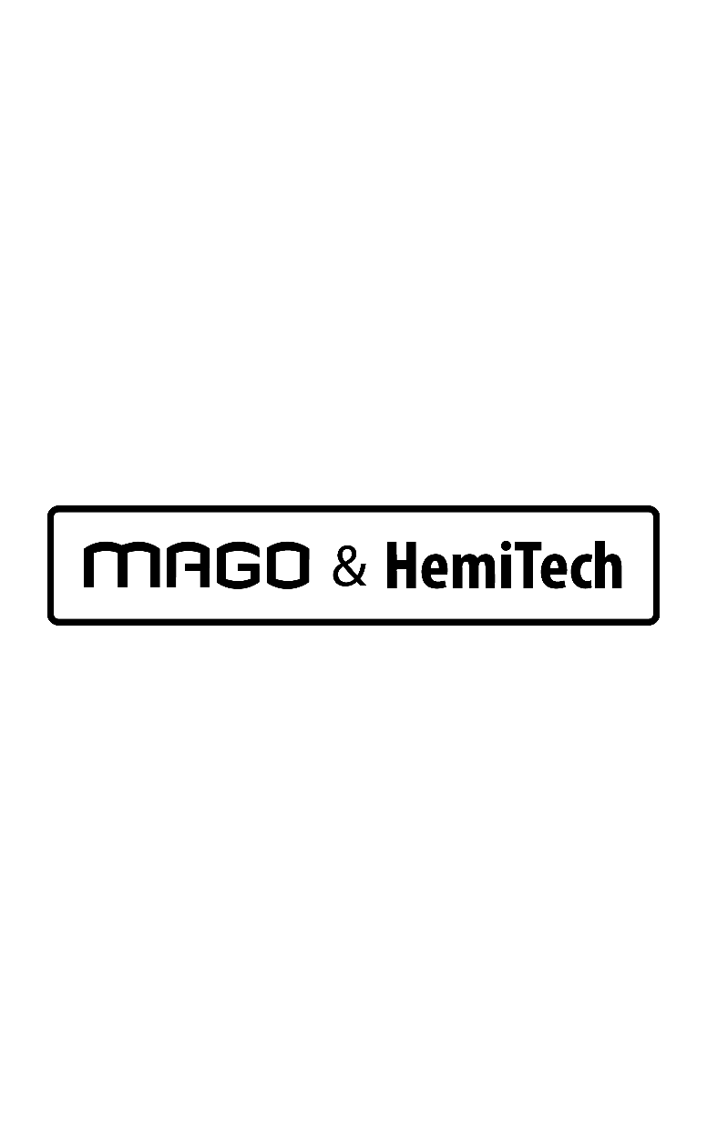
I-CART

Slide 2
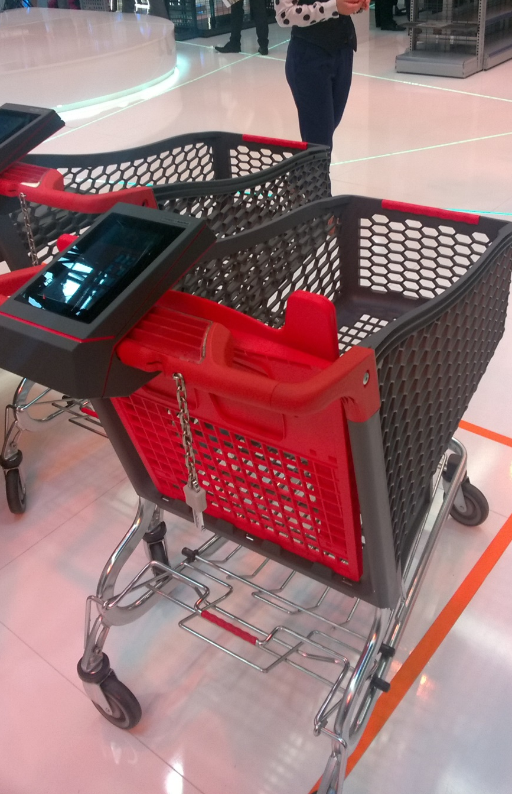
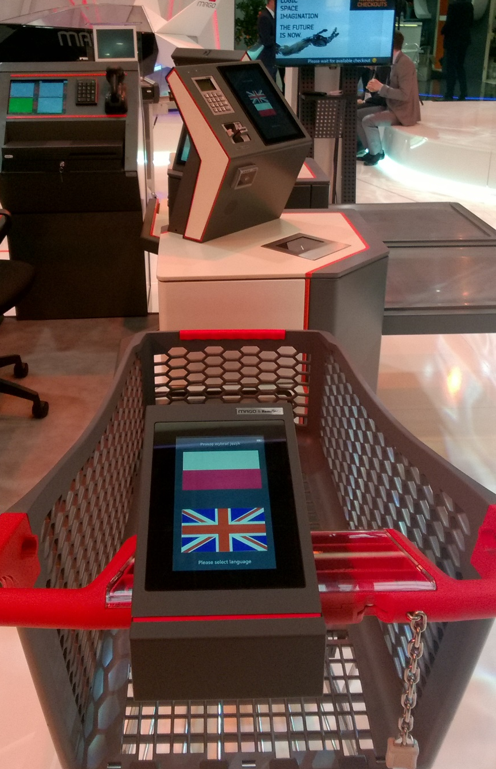
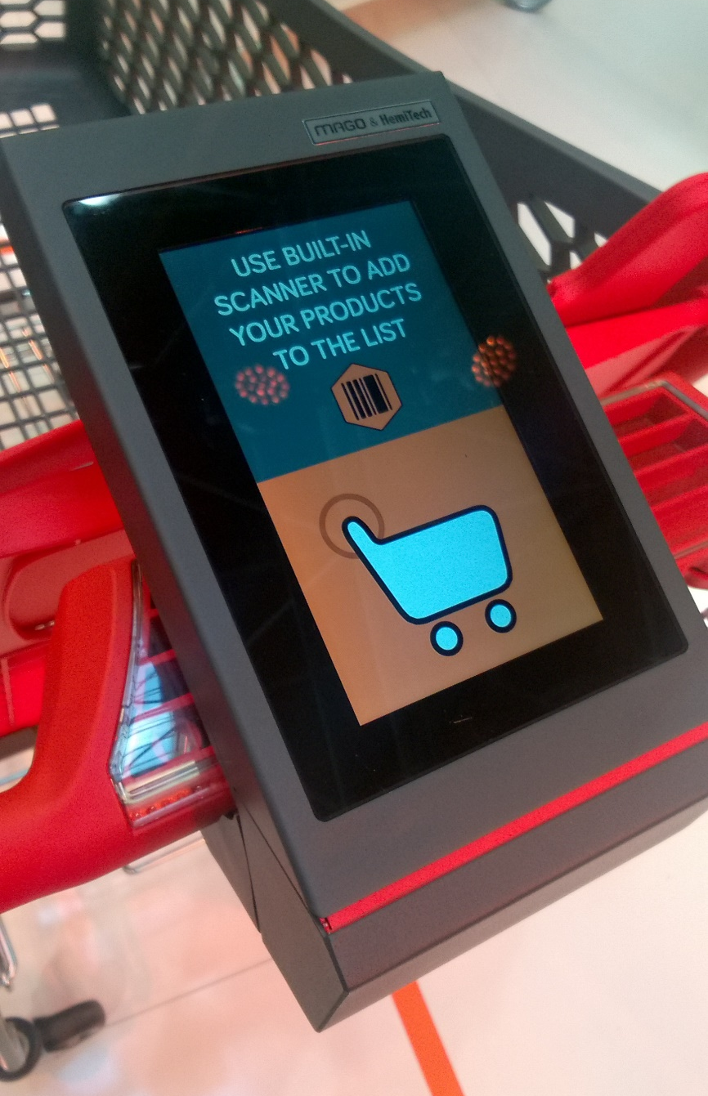

Slide 3
I-CART
Benefits:
  Mobility and self-service
  Products’ self - scanning
  Shopping list with payment details displayed on the trolley screen
  Double function: as a price checker
  Product Search by name
  Fast payment (cards, cash) in the Daisy zone
  Scanner built in trolley
  Development of new technologies

Slide 4



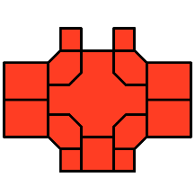








I-CART
1.
Principle of operation:
  Start shopping by initializing the application built in the trolley
  Product scanning
  Application displays the list of products with price details
  Finish shopping - go to Daisy zone (payment zone)
  Pairing I-Cart with Daisy self-checkout by entering a unique code
  Synchronize data between I-Cart and Daisy communication through Wi-Fi
  Payment by credit card or cash
  Print the receipt with the QR code which, allows the user to leave the zone Daisy
2.
3.
4.
5.
6.
7.
8.

Slide 5
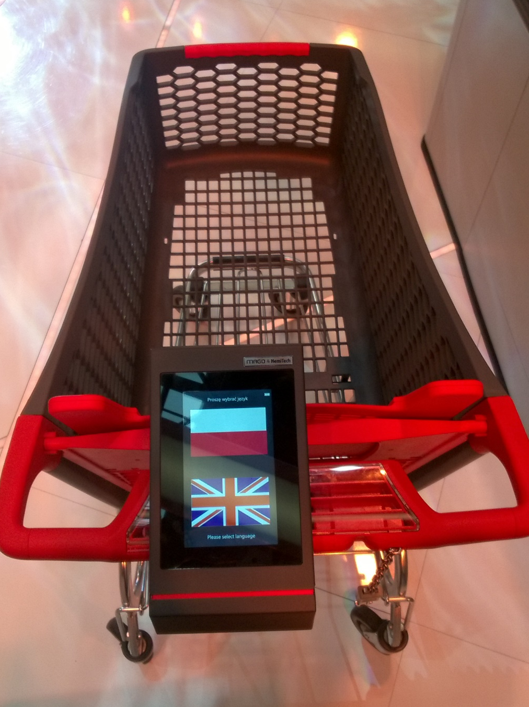
I-CART
Overview:
  Wiele możliwości konfiguracji
  Obsługa strefy checkout od skanowania, poprzez płatność, aż do wyjścia klienta ze sklepu
  Rozwiązanie zoptymalizowane kosztowo

Slide 6
CONTACT
Hemitech….

