Slide 1



Slide 2
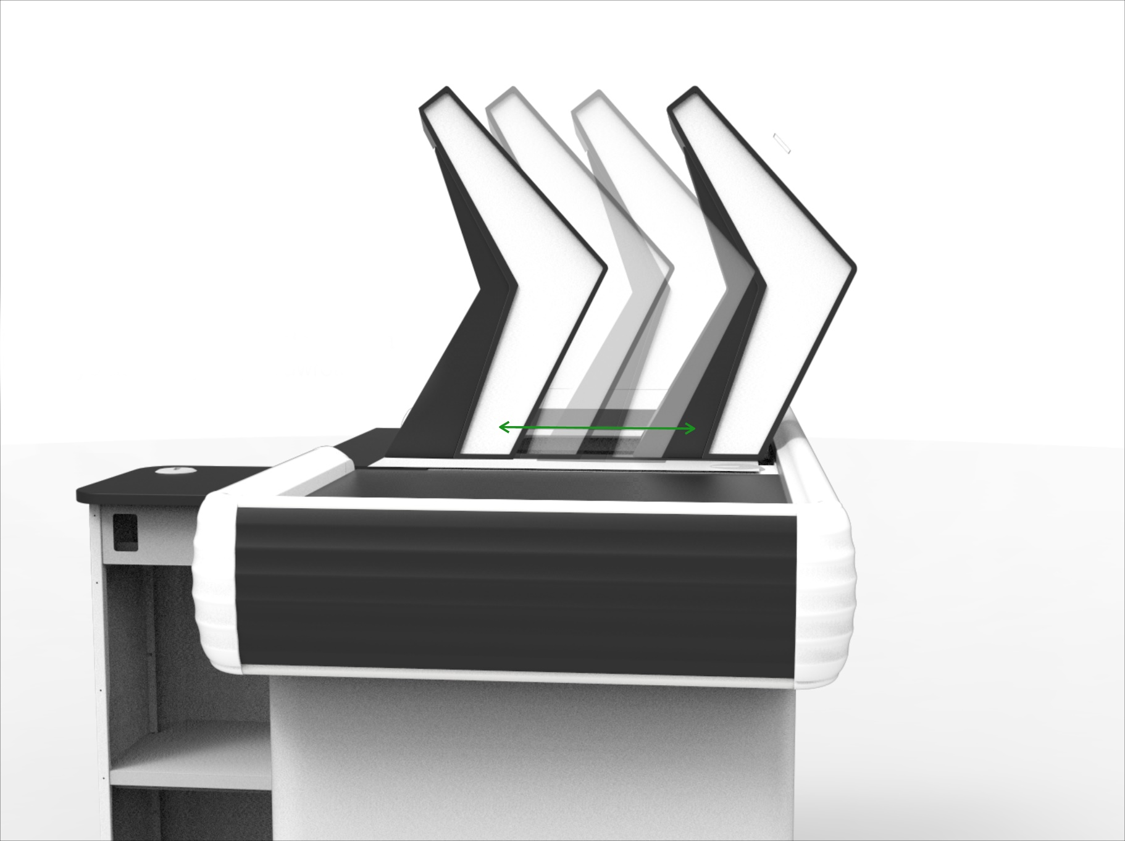
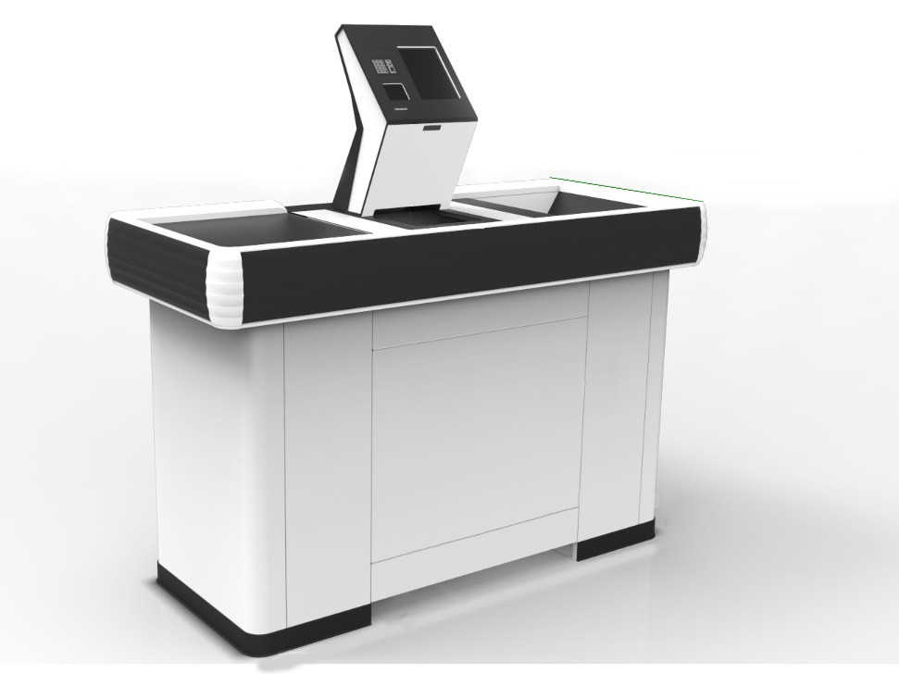
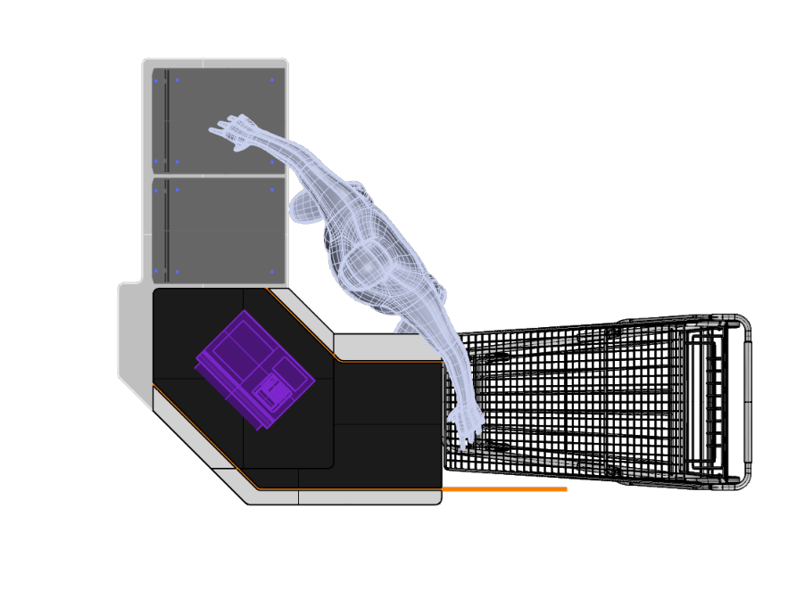


Slide 3
SPINNAKER DF
Benefits:
  All checkouts in the store can always be open
  Modern, innovative design
  Fast implementation due to the possibility to use existing store cashdesk infrastructure
  Making the Spinnaker head customizable and separating the scanning process from the payment we can offer economically optimal configuration for every client
  SCO software has been optimized so the product scanning is faster and whole checkout process takes less time

Slide 4








SPINNAKER DF
Principle of operation:
  Product scanning performed by the cashier
  End of shift and switch to SCO mode
  Product scanning performed by the client
  Payment
  QR code scanning and leaving the zone
1.
2.
3.
4.
5.

Slide 5
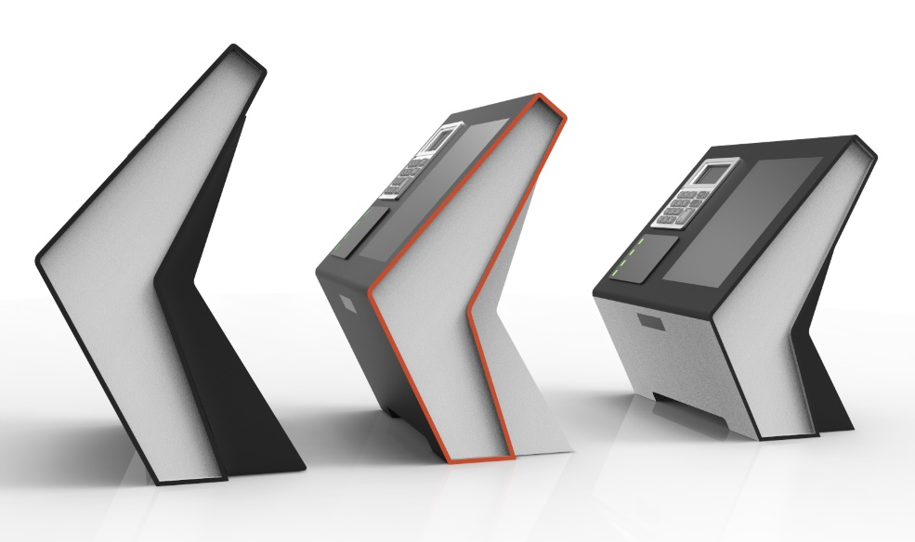
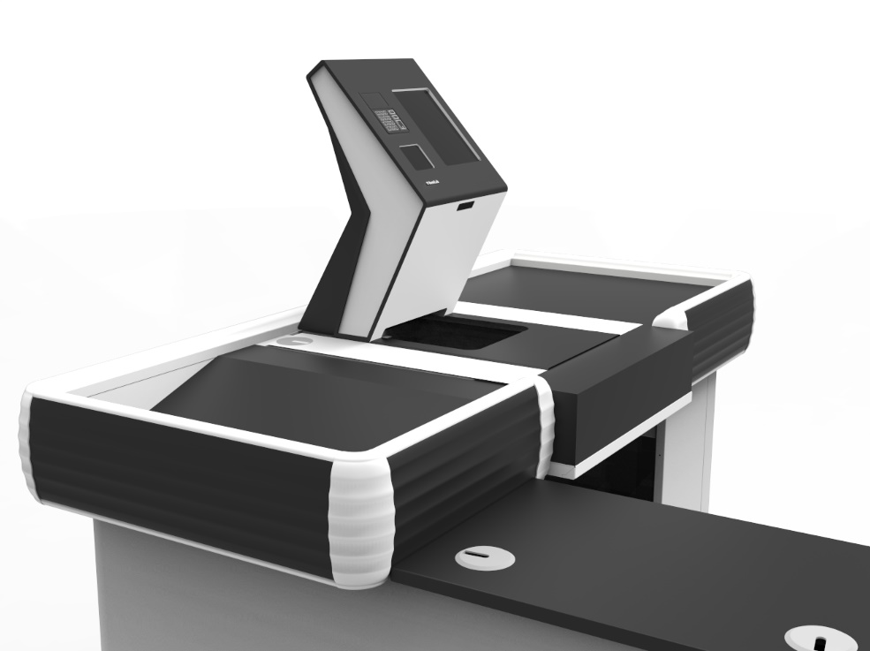
SPINNAKER DF
Overview:
  Easy implementation in existing stores
  No need for building a special Self-Checkout Zone
  Multiple configuration options
  Full management of the checkout process
  Economically efficient solution

Slide 6
CONTACT
Hemitech….

